Slide 1
Dream Team NBA Insights
Mary Brown, Melissa Mason, Deepen Patel, Saiteja Venkatapuram

Slide 2

Young people dream of what they want to do when they grow up. For many, they dream of making big money like superstar athletes portrayed in media, advertising and merchandising.
Notes:
What advice do we give young people with dreams of being a rich athlete?? Which sport? What strategy?

Slide 3
Project Description: Our team is looking to analyze why NBA players have the highest salaries on average of major professional sports leagues. We will compare various factors we believe contribute to NBA player salaries
Research Questions to Answer:
Why do NBA players on average have the highest salaries?
What attributes contribute to the salaries of NBA players?
Salary Cap
Age
Position
Social Media
NBA Salaries
Notes:
Show a bar graph of professional sports league revenue, world and then USA. Based on this graphic, you’d expect

Slide 4
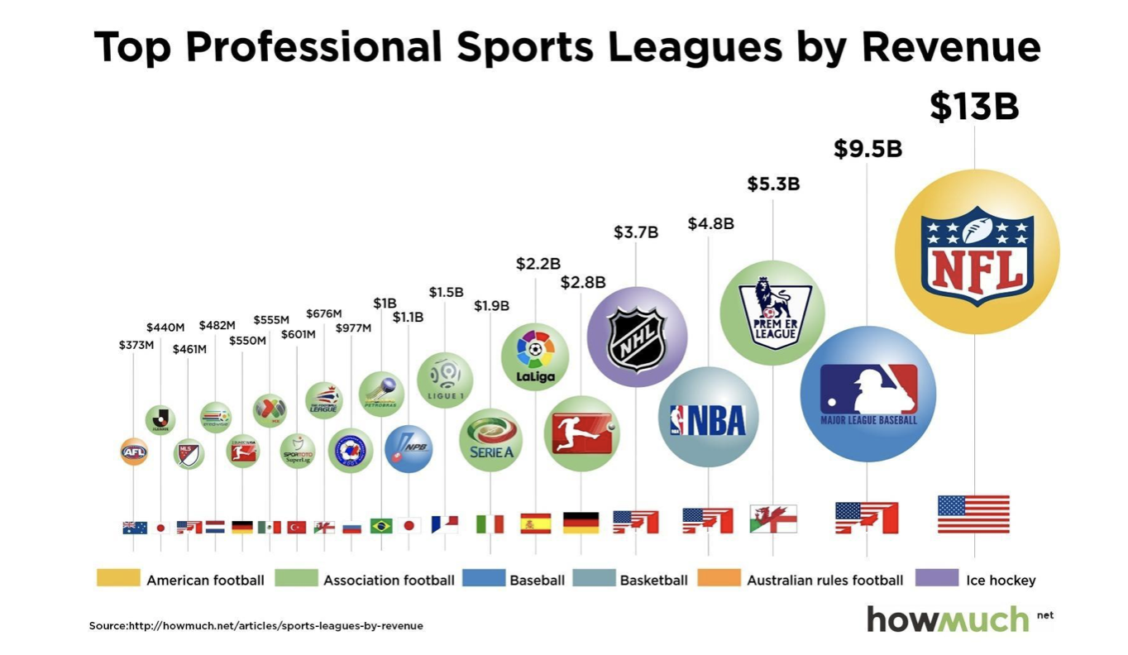
2016
Notes:
Show a bar graph of professional sports league revenue, world and then USA. Based on this graphic, you’d expect

Slide 5
Top Athletes by Salary
Salaries are soaring in team sports thanks to blockbuster TV contracts both locally and nationally, but the players at the very top of the earnings food chain separate themselves by what they make from endorsements.
2017
The five highest-paid athletes, Ronaldo, LeBron James, Lionel Messi, Roger Federer and Kevin Durant all generate more than $25 million annually from sponsors. In addition to their athletic achievements, the appeal of this group for marketers is a function of the global sports they play.
Notes:
Show a bar graph of professional sports league revenue, world and then USA. Based on this graphic, you’d expect

Slide 6
Top Paid Athletes by Sport
2017
Notes:
Show a bar graph of professional sports league revenue, world and then USA. Based on this graphic, you’d expect

Slide 7
There is no denying the numbers!! Although the NFL generates the most revenue. NBA players on average have the highest salaries!
Notes:
What advice do we give young people with dreams of being a rich athlete?? Which sport? What strategy?

Slide 8
Let’s analyze the factors that contribute to NBA player salary
Salary Cap
Player Age
Player Position
Player Game Performance Factors
Notes:
What advice do we give young people with dreams of being a rich athlete?? Which sport? What strategy?

Slide 9
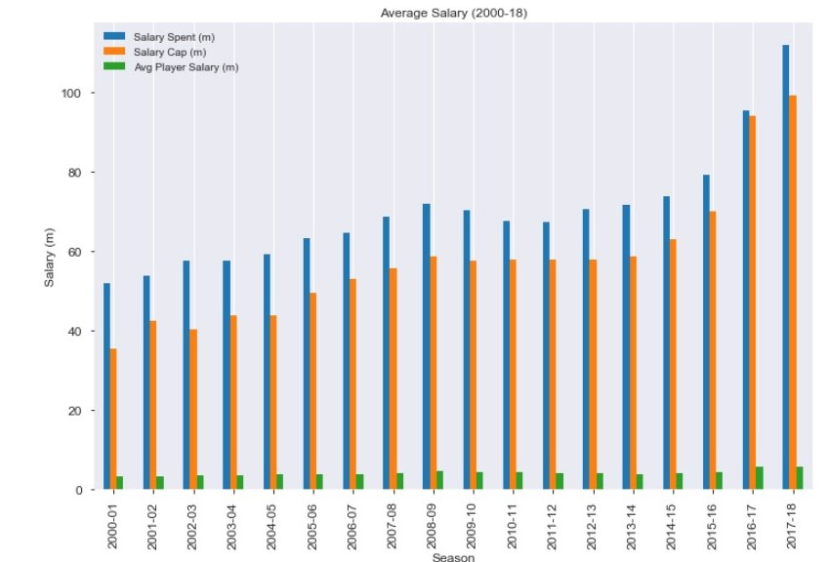
Salary Cap
Salary cap is derived from basketball-related income, or BRI which includes revenue from ticket sales, TV rights, merchandise sales, championship parades and etc...Please keep in mind that there are many rules and regulations that go into a player's contracts.
One of the questions we would like to answer is whether salary cap is a good predictor of player income?

Slide 10
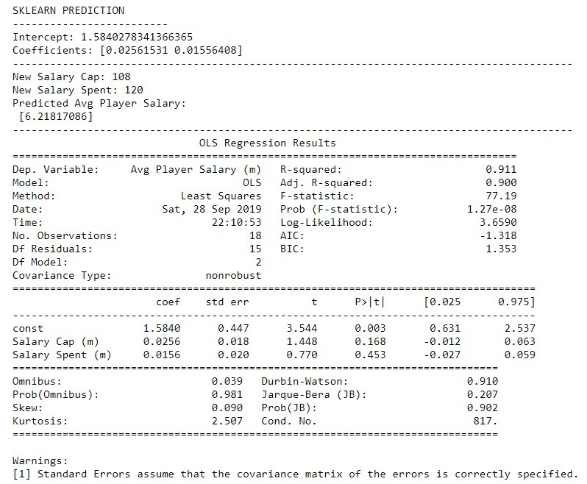
Salary Cap
Dependent Variable:
Average Player Salary
Independent Variables:
Average Salary Cap
Average salary spent by teams
Based on this model, we can say that as salary cap increases so does the average player salary, but it doesn’t show why some players end up making more money than the others.

Slide 11
Player Age
The correlation between average player salary and player age is 0.5, suggesting a moderate correlation between Age and Salary. Looking at the graph confirms this as the salary tends to increase as the player age increases
Notes:
Show a bar graph of professional sports league revenue, world and then USA. Based on this graphic, you’d expect

Slide 12
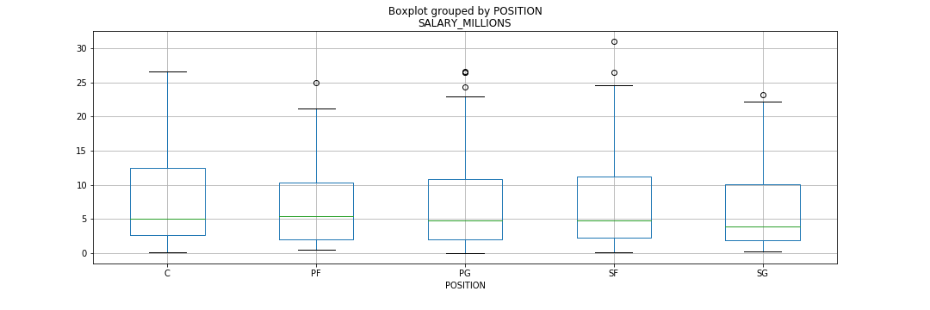
Box Plot by Position

Slide 13
T-Tests
Position | P-Value | Hypothesis Test
Centers | 0.37 | Fail to Reject H₀
Power Forwards | 0.58 | Fail to Reject H₀
Small Forwards | 0.60 | Fail to Reject H₀
Point Guards | 0.99 | Fail to Reject H₀
Shooting Guards | 0.28 | Fail to Reject H₀
Null Hypothesis (H₀) = Average Position Salary IS comparable to the League’s Average Salary
Alternate Hypothesis (H₁) = Average Position Salary IS NOT comparable to the League’s Average Salary (Threshold P-Value = 0.05)

Slide 14
ANOVA TEST
Null Hypothesis (H₀) = There IS NO difference in salary between the various positions
Alternate Hypothesis (H₁) = There IS a difference in salary between the various positions (Threshold P-Value = 0.05)
P-Value = 0.66
Fail to Reject Null Hypothesis (H₀)

Slide 15
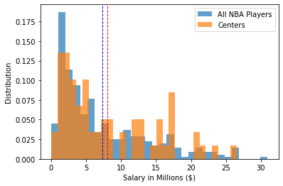
Centers’ Salary Distribution

Slide 16
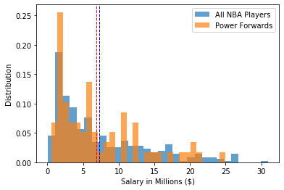
Power Forwards’ Salary Distribution

Slide 17
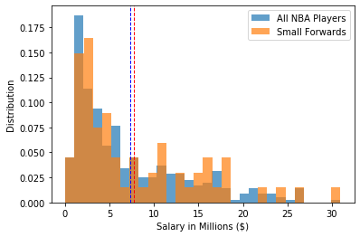
Small Forwards’ Salary Distribution

Slide 18
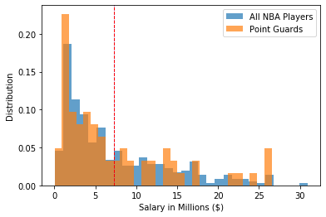
Point Guards’ Salary Distribution

Slide 19
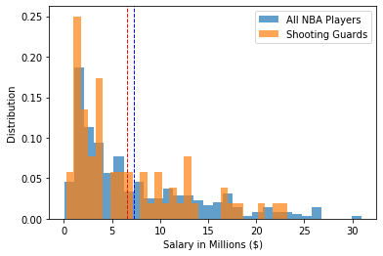
Shooting Guards’ Salary Distribution

Slide 20
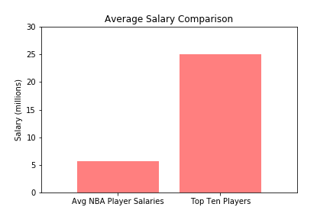
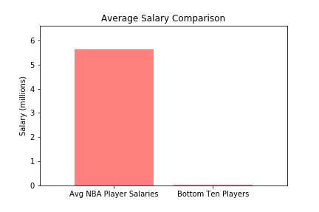
When we compare the average salary of all NBA player with that of the top 10 players and the bottom 10 players, we can see that there is a large disparity in the average salaries. Our goal was to investigate whether certain factors contributed to a players salary earnings.

Slide 21
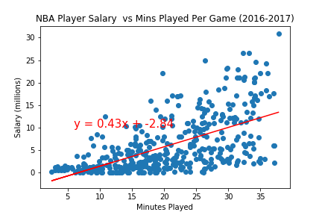
The correlation between player salary and minutes played per game is 0.6 which indicates that there is a moderate correlation between the two factors.

Slide 22
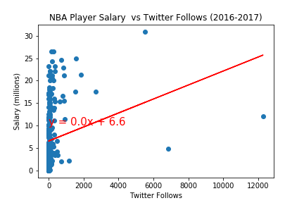
The correlation between player salary and Twitter followers is 0.22 which indicates that there is a very weak correlation between the two factors. From the data analysis is appears that Twitter usage does not have an impact on player salary.

Slide 23
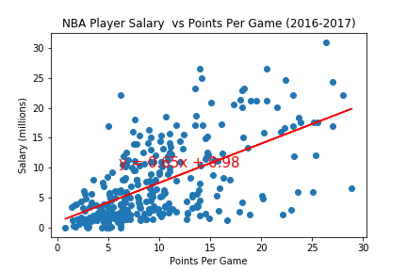
The correlation between player salary and points per game is 0.61, which indicates that there is a moderate correlation between the two factors.

Slide 24
Conclusions
Notes:
What advice do we give young people with dreams of being a rich athlete?? Which sport? What strategy?

Slide 25
Appendix
Salary data
https://www.kaggle.com/hultm28/nba-player-salary-data-2002-2017
Player Stats:
https://www.kaggle.com/yalcinberkay/nba-matches-dataset-w-player-stats/version/3
Basketball Statistics:
https://www.basketball-reference.com/
ESPN:
http://www.espn.com/nba/salaries/_/seasontype/4
NBA
https://www.statista.com/topics/967/national-basketball-association/
https://www.kaggle.com/sonicp/nba-player-power-influence-and-performance-8c287c

Slide 26
Sources
https://www.kaggle.com/noahgift/social-power-nba#nba_2017_nba_players_with_salary.csv

